Slide 1
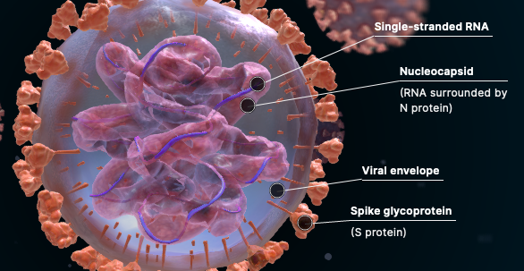
COVID 19 Vaccine Educational Brief Kevin E Mackey MD, FAEMS Sacramento Regional Fire

Slide 2
Essential Scientific Material is Included to Address Common Questions

Slide 3
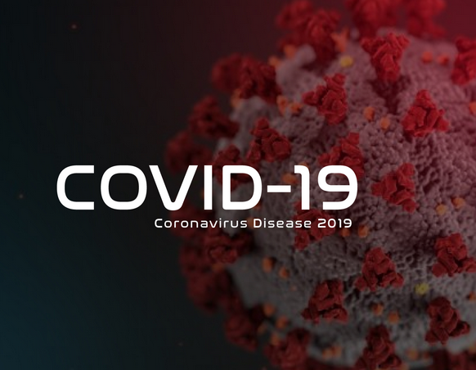
SARS-CoV2 Virus Explained
“SARS” = Severe Acute Respiratory Syndrome
CoV = Coronavirus
COVID 19= COronaVIrus Disease - 19 (first identified in 2019)
It is considered a “novel” virus, meaning there are no previous human diseases involving this virus’ exact genetic make up
It IS considered to belong to the Coronavirus family, typically causing respiratory illness, along with virus that are less lethal (common cold) and more lethal (SARS, MERS)

Slide 4
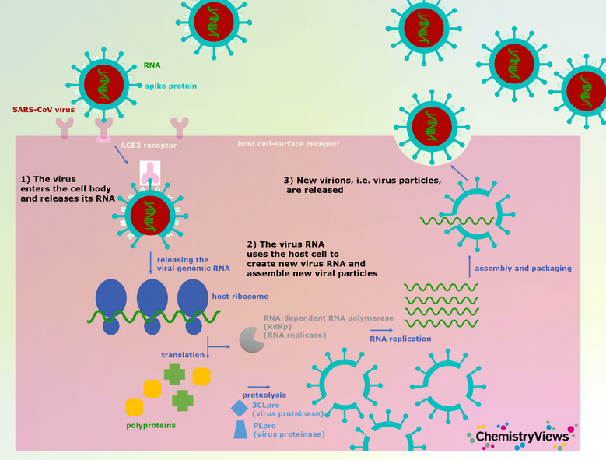
How Does COVID Infect Humans?
The COVID 19 virus preferentially binds to human cells expressing ACE2 receptors (highest cell count is in the respiratory system)
Binds via the spike proteins found on the surface of the virus
Once bound to the cell, the virus undergoes a structural change allowing it to bind to the surface of the cell so it can enter the cell
Once inside, the viral genome is replicated using the host’s own cells to make new virus particles, which are then released from the cell

Slide 5
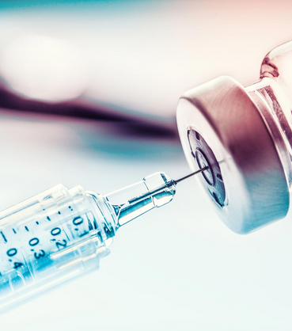
The COVID-19 Vaccine

Slide 6
Two Leading Developers

Slide 8
Why is an EUA necessary?
Under normal, non-pandemic situations, most vaccine development happens in non-humans (ie: animals, in vitro testing)
In emergency circumstances (ie: a pandemic), the FDA will allow tightly controlled, limited testing in healthy human volunteers in three phases
Phase 1: Limited small scale testing for safety in healthy human volunteers (generally 100 - 200)
Phase 2: Limited testing of varying doses, reconfirming safety profile (generally 1000 – 2000)
Phase 3: Tens of thousands of human volunteers accessing how well the vaccine works against the target (ie: COVID virus), with continued safety assessment

Slide 9
Pfizer Phase 3 Stats

Slide 10
Pfizer Phase 3 Results
Over 44,000 vaccinated volunteers
95% effective beginning 7 days after Dose 2
170 total COVID + cases observed in the 44,000
162 in placebo group, 8 in immunized group after Dose 1
3 in placebo group, 1 in immunized group after Dose 2
10 cases of SEVERE COVID disease: 9 in placebo group, one in the vaccinated group
Durability of immune protection under investigation

Slide 11
Moderna Phase 3 Results
Over 25,650 fully vaccinated (both doses) volunteers
7000 over age 65
42% of enrollment in medically high risk populations (co-infection with HIV, HepB, HepC, diabetes)
28% minority vaccinated volunteers
Durability of immune protection: recent study in NEJM shows excellent antibody protective ability 90 days after the second injection

Slide 12
Side by Side Comparison
Pfizer
Moderna
RNA-based vaccine
Two injections, spaced 21 days apart
95% effective (Phase 3) at preventing SERIOUS disease after first injection
Common side effects: injection site pain, self-limited fever, fatigue, headache, muscle or joint pain
RNA based vaccine
Two injections, spaced 28 days apart
94% effective (Phase 3) at preventing SERIOUS disease after first injection
Common side effects: Injection site redness, self-limited fevers (especially with second dose), headache, fatigue

Slide 13
How does the vaccine actually work? Hint: Replication

Slide 14
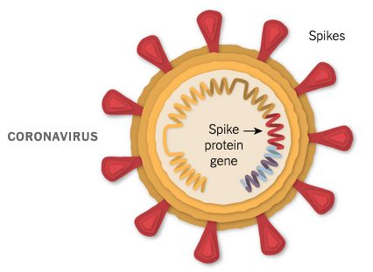
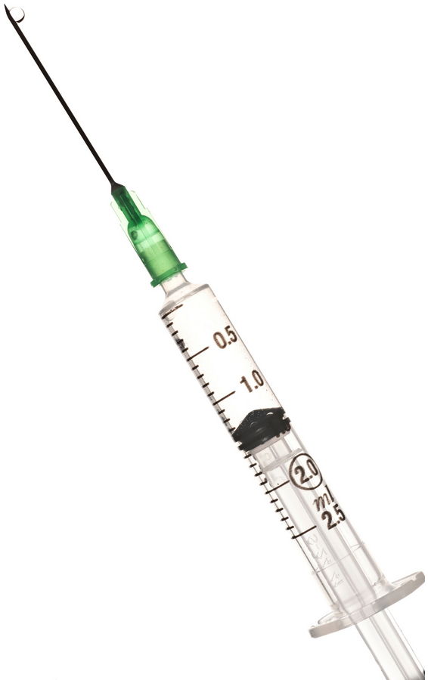
Spike protein isolated/sequenced in lab
RNA segment replicated
RNA Segment Inserted
in lipid (fat) molecule

Slide 15
- Viral mRNA encoding spike protein floating taken up into cell. - The human cell’s own manufacturing plant (ribosomes) assemble the viral spike proteins - Non-infectious spike proteins remain in the cell until the cell dies naturally, at which time the spike proteins are released - If an immune response is already present to the viral spike proteins, the immune response will accelerate the release of the spike proteins
***Note: the nucleus of the cell containing the DNA is not involved***

Slide 16
Viral spike proteins released from vaccinated cells are picked up by our own immune cells (called macrophages) which then process and “present” the spike proteins for the entire immune system to see and “learn”
“Helper” T cells “memorize” what the spike protein looks like and programs itself to be able to “describe” the spike protein to the real army of the immune system, the mighty B cell

Slide 17
Helper T cells, now equipped to activate other immune cells, engage with the antibody producing B cells Activated B cells now seek out cells that are expressing the spike proteins and destroy them

Slide 18
Antibodies produced in and released by B cells now flow through the body looking for any cell containing the spike protein (like SARS-CoV 2 infected cells) and destroys them thereby stopping the spread of the infection to nearby cells.

Slide 20
Myth: The COVID 19 Vaccine will stop you from contracting COVID-19
Fact: You can still contract COVID-19. HOWEVER the risk of serious disease and disease long-term sequelae is almost 100% neutralized , which is the goal of ANY vaccine.

Slide 21
Myth: The process of vaccine development was rushed and haphazard
Fact: Vaccine development was operated under an established program specifically designed to deal with this type of circumstance, called an Emergency Use Authorization, closely monitored for safety by the FDA

Slide 22
Myth: There have not been any prior RNA vaccines used in humans
Fact: False. RNA vaccine technology has been used to treat gastric cancer in humans and hATTR, a rare debilitating human peripheral nerve disease.

Slide 23
Myth: RNA vaccines can implant material into the human genome or fundamentally change a human’s genetic structure
Fact: This is simply not true and frankly, biologically impossible. An RNA vaccine utilizes a cell’s innate processes to produce inert viral particles for the purpose of activating the human immune response. The cell that does this is ultimately destroyed by the immune system. , which is the goal of ANY vaccine.

Slide 24
Myth: The COVID 19 Vaccine will stop you from contracting COVID-19
Fact: You can still contract COVID-19. HOWEVER the risk of serious disease and disease long-term sequelae is almost 100% neutralized , which is the goal of ANY vaccine.

Slide 25
Myth: Ill effects from the vaccine won’t be seen for months or years
Fact: 70 years of vaccines refute this. Under an EUA, 50% of all individuals vaccinated must have received all doses and 90 days must have passed to assess for side effects. For COVID-19, over 75000 have received both doses and NO serious side effects have occurred.

Slide 26
Changes to PPE Use After Vaccination
Vaccine Distribution

Slide 27
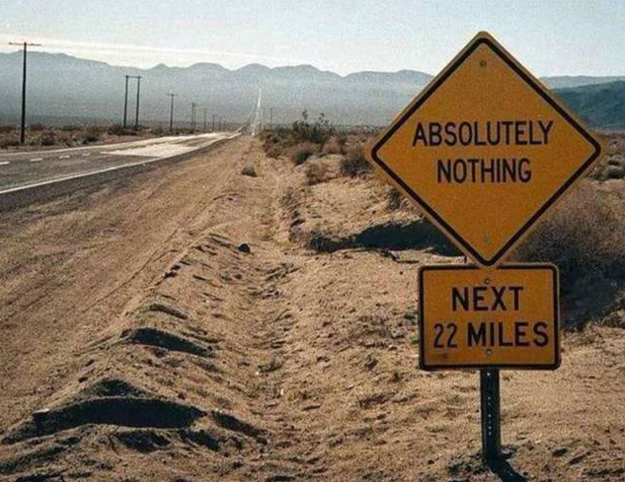
Will PPE Use Change After Vaccination?

Slide 28
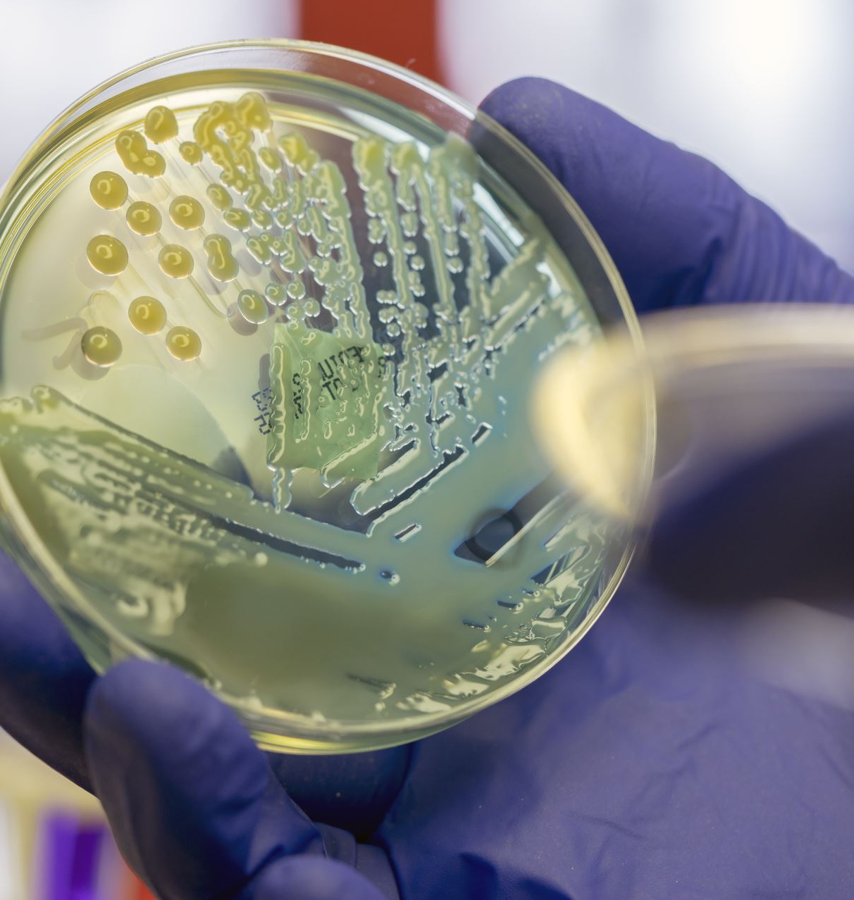
PPE use shall continue until morale improves!
NOTHING changes. PLEASE continue to follow PPE guidance using eye protection, face masks, gloves, frequent hand sanitizing, cleaning procedures for equipment, and follow department specific and local policies. PROTECT YOURSELF, and PROTECT OTHERS!

Slide 29
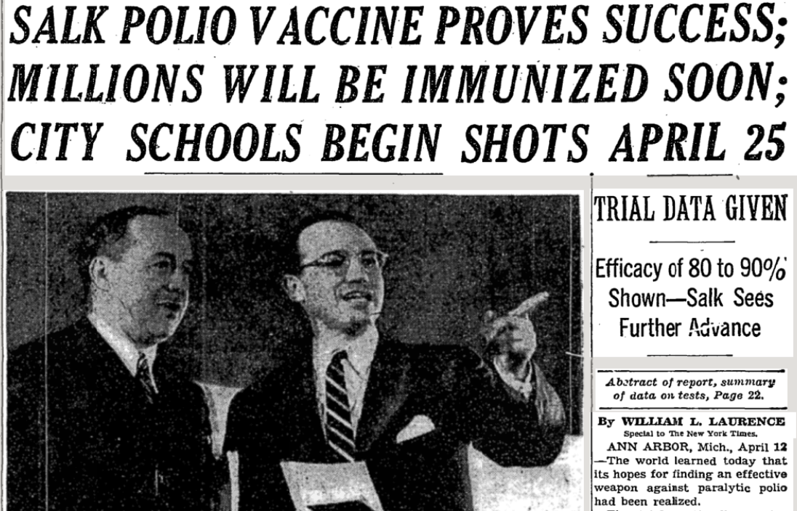
How will vaccines be distributed?

Slide 30
Operation Warp Speed

Slide 31
Operation Warp Speed
Partnership with Department of Health and Human Services (HHS), including the Centers for Disease Control and Prevention (CDC), the National Institutes of Health (NIH), and the Biomedical Advanced Research and Development Authority (BARDA), and the Department of Defense (DoD).
Phased approach
Phase 1: focused, limited doses available, healthcare workforce and frontline workers
Phase 2: larger supplies available, expand to at risk populations first, as well as essential infrastructure, then general population
Phase 3: if pandemic persists, integration into routine vaccine programs and broadscale vaccine distribution

Slide 32
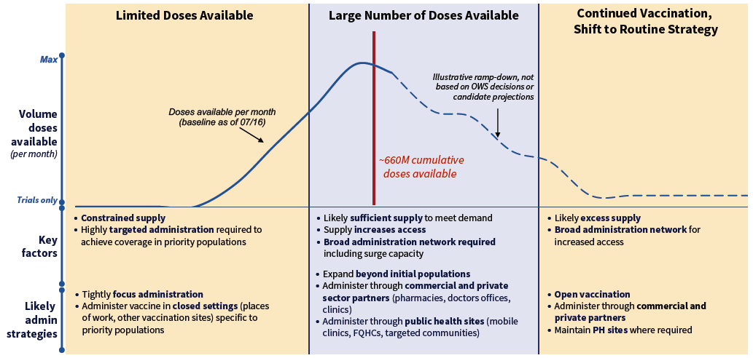

Slide 33
References

Slide 34
SARS CoV2 explained and how human infection occurs
https://en.wikipedia.org/wiki/Coronavirus_disease_2019#Virology
https://www.chemistryviews.org/details/ezine/11225161/Coronavirus_Entering_and_Replicating_in_a_Host_Cell.html
What is an EUA?
https://www.who.int/emergencies/diseases/novel-coronavirus-2019/covid-19-vaccines/how-are-vaccines-developed
https://www.fda.gov/vaccines-blood-biologics/vaccines/emergency-use-authorization-vaccines-explained
https://www.drugtopics.com/view/fda-permits-emergency-use-experimental-treatments-covid-19
Pfizer vaccine and trial results
https://www.businesswire.com/news/home/20201118005595/en/
https://www.pfizer.com/news/press-release/press-release-detail/pfizer-and-biontech-conclude-phase-3-study-covid-19-vaccine
https://www.fda.gov/advisory-committees/vaccines-and-related-biological-products-advisory-committee/2020-meeting-materials-vaccines-and-related-biological-products-advisory-committee
Moderna vaccine and trial results
https://investors.modernatx.com/news-releases/news-release-details/moderna-completes-enrollment-phase-3-cove-study-mrna-vaccine
https://www.nih.gov/news-events/news-releases/promising-interim-results-clinical-trial-nih-moderna-covid-19-vaccine

Slide 35
How the Pfizer and Moderna COVID vaccine work/durability
https://www.nytimes.com/interactive/2020/health/pfizer-biontech-covid-19-vaccine.html
https://www.nytimes.com/interactive/2020/health/moderna-covid-19-vaccine.html
https://www.nejm.org/doi/full/10.1056/NEJMc2032195
Prior RNA vaccine use to treat disease
https://www.ncbi.nlm.nih.gov/pmc/articles/PMC7177048/
https://www.jci.org/articles/view/134915
https://www.fda.gov/news-events/press-announcements/fda-approves-first-its-kind-targeted-rna-based-therapy-treat-rare-disease#:~:text=FDA%20News%20Release-,FDA%20approves%20first%2Dof%2Dits%20kind%20targeted%20RNA%2Dbased,to%20treat%20a%20rare%20disease&text=The%20U.S.%20Food%20and%20Drug,(hATTR)%20in%20adult%20patients.
Vaccine distribution plan
https://www.hhs.gov/coronavirus/explaining-operation-warp-speed/index.html
https://www.hhs.gov/sites/default/files/strategy-for-distributing-covid-19-vaccine.pdf

